Slide 1




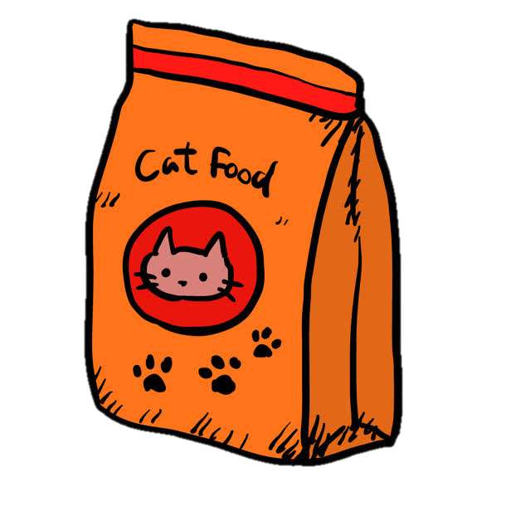




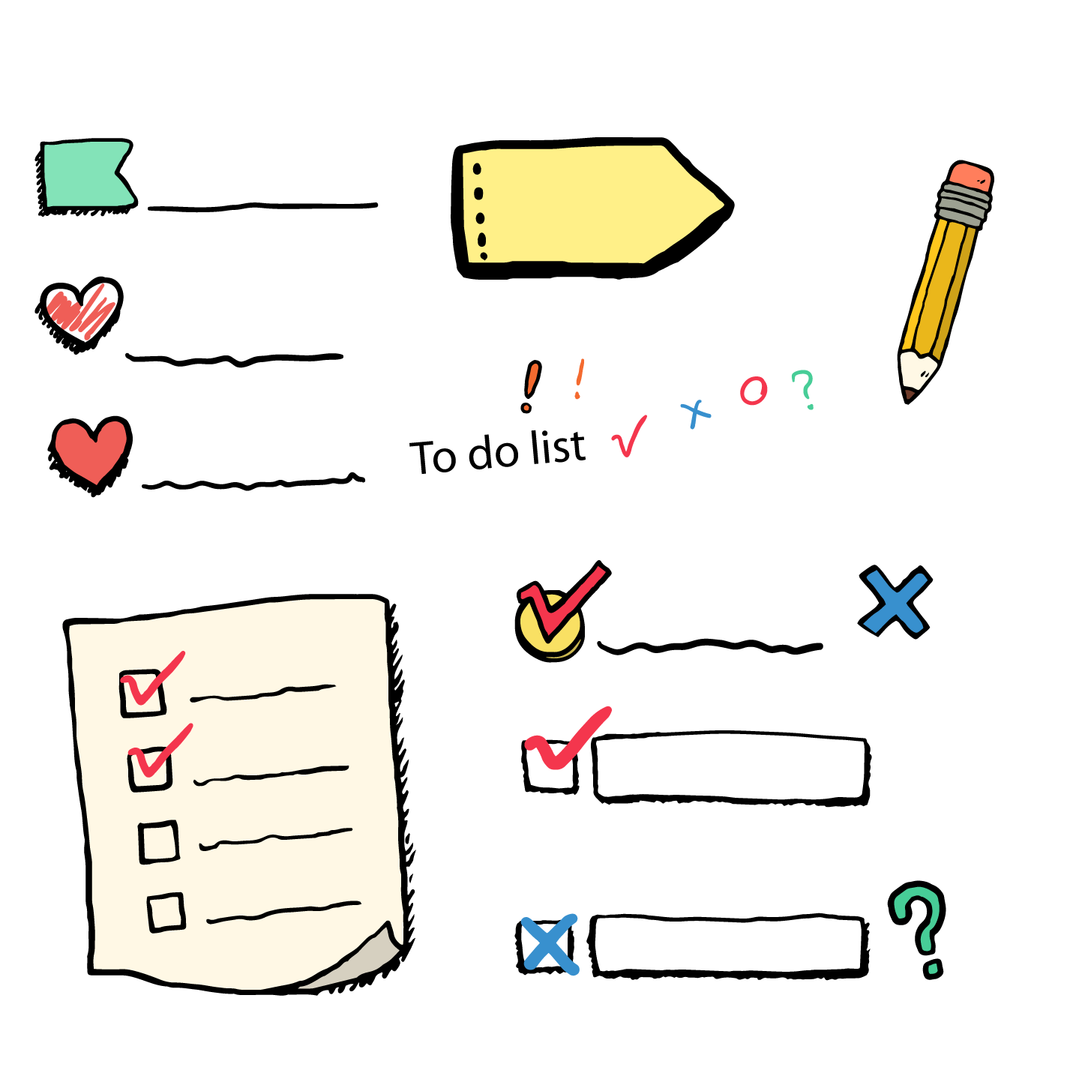
Pet Automatic Feeder
based on Raspberry Pi
1
2
Automatic dumping
Feeding function
I want to ensure that I eat regularly every day.
I want to eat fresh food that won't make me sick.
video monitor
I'm afraid my keeper will worry about me or miss me.
Other functions
I also want an interactive feeder.
3
……
Let's listen to what kind of
feeder Nana wants
Team Number 35

